Slide 1


Washington’s ESSA Plan for School Accountability
Woodland School Board Presentation March 2018

Slide 2
Starting with the Why…
ESSA does not dictate a system for federal accountability, but allows (within limits) each state to customize its own accountability framework, including allowing states to determine how to judge student performance and how to hold teachers accountable.

Slide 3
What are some of the changes in the shift to the Every Student Succeeds Act?
No Child Left Behind
100% Proficiency Standard
School Failure Letters Home
“Highly Qualified” Requirement
SES Set-Asides and School Choice
Required School Turnaround Models
Cascading Sanctions
Every Student Succeeds Act
Emphasis on Growth and Gaps
Schools Identified for Support
Effective Educators
Local Control on Spending
LEA and SEA Improvement Models
LEA School Supports

Slide 4
The What:
Accountability Framework

Slide 5
ESSA Performance Indicators
Academic Indicators
School Quality or Student Success
Elementary
Proficiency
Growth
English Learner Progress
Chronic Absenteeism
Middle School
Proficiency
Growth
English Learner Progress
Chronic Absenteeism
High School
Chronic Absenteeism
Proficiency
Graduation Rate
English Learner Progress
9th Graders on Track
Advanced Course Taking
Notes:
Washington’s framework: each measure is mapped from a percentage to a 1–10 score.
Those measure scores are combined to yield an overall index score ranging from 1–10.
Using that ESSA index score, the lowest performing 5 percent of schools are identified as comprehensive support schools.
Schools will be identified for targeted support using the same threshold for specific student groups.
The approach emphasizes continuous improvement for ALL schools, not just whether a school is on or off a list.

Slide 6

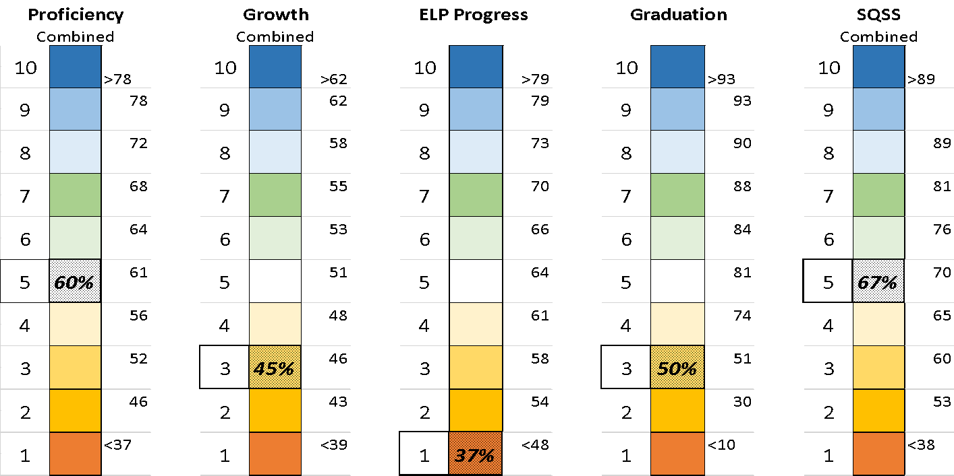
ESSA Index & Lowest Performing 5%
✗

Slide 7
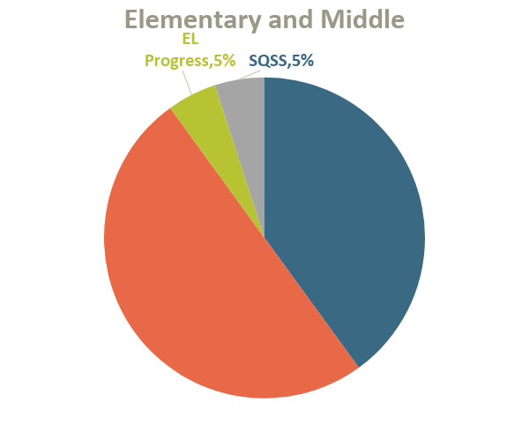
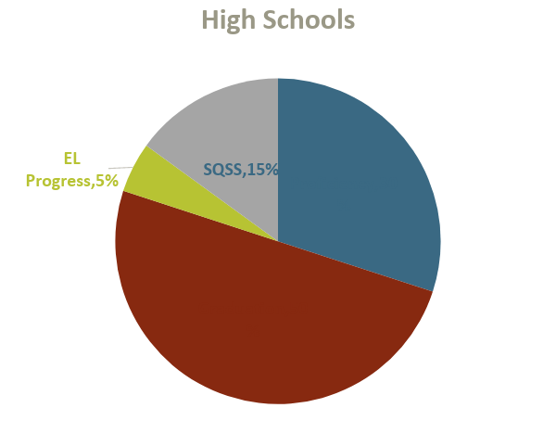
ESSA Index Weights
5%
15%
5%
5%
30%
40%
 | Student Growth
 | Graduation
 | Proficiency
 | EL Progress
 | SQSS
50%
50%

Slide 8
Timeline of Accountability
 | 14–15 | 15–16 | 16–17 | 17–18 | 18–19 | 19–20 | 20–21 | 21–22 | 22–23 | 23–24
ESSA Identification and Support | Proficiency Growth Graduation English Learner Progress SQSS |  |  | Data calculations Identify Planning | Support | Support | Support
ESSA Identification and Support |  |  |  | Proficiency* Growth Graduation English Learner Progress SQSS** |  |  | Data calculations Identify Planning | Support | Support | Support

Slide 9
Which of Woodland’s schools were identified as needing additional support?
Two of Woodland’s schools were identified as having 1-2 student groups with scores falling into the “Targeted” supports category and one was identified with “Comprehensive” needs.
At Woodland Intermediate School, the English Language Learner (ELL) program and one demographic group were identified as Targeted.
At Woodland Middle School, the English Language Learner (ELL) and Special Education program were identified as Targeted.
TEAM High School, Woodland’s alternative high school, was identified for having a low graduation rate, however, due to the small comparable student enrollment, TEAM High is eligible for opting out of Comprehensive supports.

Slide 10
The How:
District and School Support

Slide 11
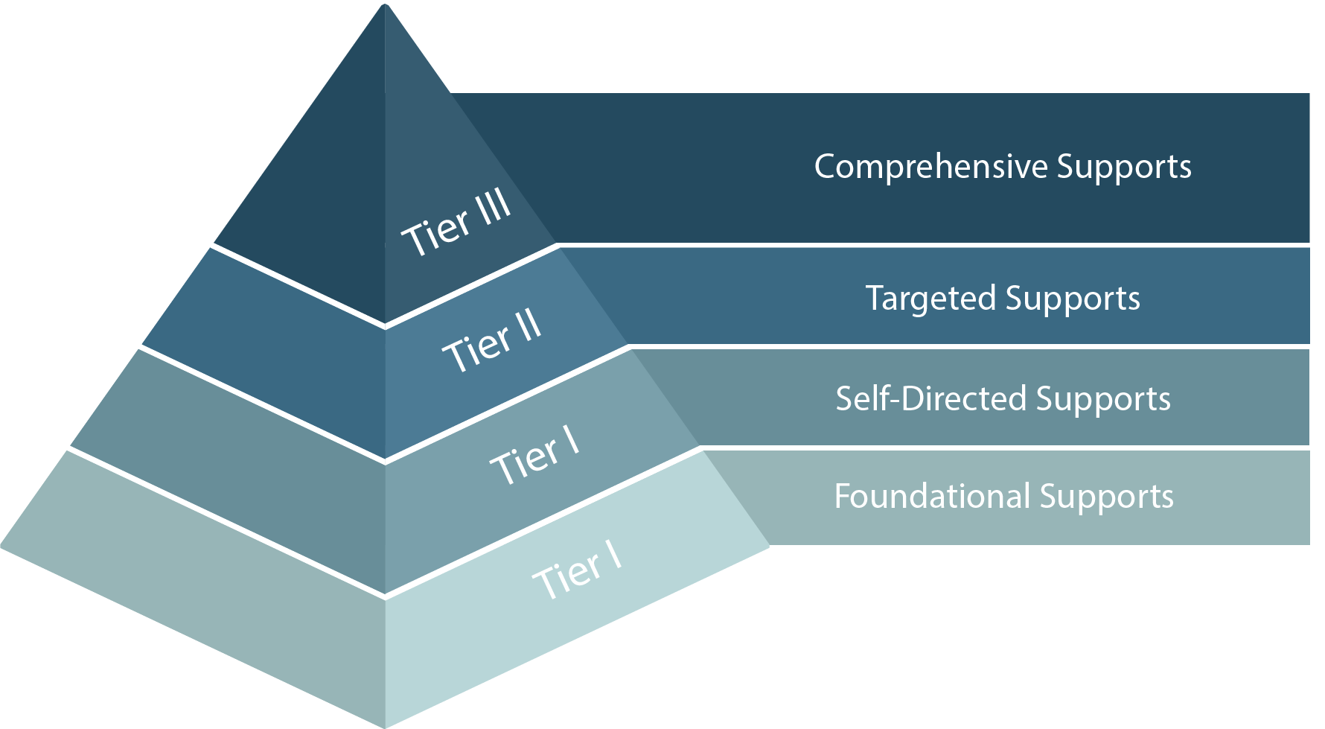
NCLB Era: We identified the bottom 10% of schools in Priority and Focus
Supports were relatively undifferentiated
ESSA Era: We’ve established a baseline of performance and all schools that fall under this are identified as either Comprehensive or Targeted
Supports are differentiated and matched to need
RAD
RAD + Comprehensive
Priority
Leadership coach
Instructional Coach
Grants
Targeted > 3
Targeted
2 > x > 1
Focus
All-Schools
All-Schools
Less Differentiated
Differentiation
More Differentiated

Slide 12
More Information to Come…
Fiscal guidance
New electronic grants system
Revised Consolidated Programs Reviews
Tiered Supports

